Slide 1
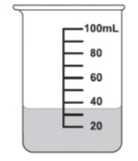

Measurement Interactive Notebook
Name
Class
Teacher Mr Evans
Term 3 Semester 2
1

Slide 2
Contents
Glossary or Formula Page
Page
Date
Description
2
3

Slide 3
Tasks
24
7
30
Essential Question
Questions
Notes
Summary
4
5

Slide 4
Warm up
Solve the following equations:
20=
15=
8=
7=
16=
32
X
X
2
21
X
X
3
64
X

Slide 5
24
7
30
Date
Introduction to Trigonometry
EQ – How do you find the length of the sides of a right angled triangle if you have a given angle size?
5

Slide 6
Trigonometry (Triangle Measurement)
We can use trigonometry to find missing angles and lengths of triangles.
Trigonometry uses three functions, these are called:
Sine (shortened to Sin and pronounced “sign”)
Cosine (shortened to Cos)
Tangent (shortened to Tan)

Slide 7
Labelling the sides
Before we can use Sin, Cos and Tan we need to be able to label the sides of a right angled triangle
The longest side, the one opposite the right angle is called the hypotenuse
Hypotenuse

Slide 8
Labelling the sides
What we call the other two sides will change depending on which angle we are working with, for example..
If we are given (or need to work out) this angle, we label the other sides like this..
Adjacent
Opposite
But if we are working with this angle, we label the sides like this...
ϴ
Opposite
Adjacent

Slide 9
Labelling Right Angle Triangle
10 multiple choice questions

Slide 10
What is the side marked with an X?
X
ϴ
Adjacent
Opposite
A)
B)
Hypotenuse
C)

Slide 11
What is the side marked with an X?
ϴ
X
Hypotenuse
Opposite
A)
B)
Adjacent
C)

Slide 12
What is the side marked with an X?
X
ϴ
Hypotenuse
Opposite
A)
B)
Adjacent
C)

Slide 13
What is the side marked with an X?
ϴ
X
Opposite
Adjacent
A)
B)
Hypotenuse
C)

Slide 14
What is the side marked with an X?
X
ϴ
Adjacent
Opposite
A)
B)
Hypotenuse
C)

Slide 15
What is the side marked with an X?
X
ϴ
Opposite
Adjacent
A)
B)
Hypotenuse
C)

Slide 16
What is the side marked with an X?
ϴ
X
Opposite
Adjacent
A)
B)
Hypotenuse
C)

Slide 17
What is the side marked with an X?
X
ϴ
Opposite
Hypotenuse
A)
B)
Adjacent
C)

Slide 18
What is the side marked with an X?
ϴ
X
Hypotenuse
Adjacent
A)
B)
Opposite
C)

Slide 19
What is the side marked with an X?
X
ϴ
Hypotenuse
Opposite
A)
B)
Adjacent
C)

Slide 20
Tangent (tan)
We use cosine when we have the Opposite and Adjacent lengths.
10cm
The rule we use is:
50˚
Opposite
Adjacent
Tanϴ=
6.4cm (1dp)

Slide 21
Tan Example 1
53˚
We can use Tan as the question involves the Adjacent and Opposite lengths
11cm
The rule we use is:
Opposite
Adjacent
O
Tanϴ=
O
11
Tan53=
11 x Tan53= O
14.6 cm (1dp)= O

Slide 22
Tan Example 2
35˚
A
We can use Tan as the question involves the Adjacent and Opposite lengths
The rule we use is:
21cm
Opposite
Adjacent
Tanϴ=
21
A
Tan35=
A x Tan35= 21
A= 21
Tan35
A= 29.99 cm (2dp)

Slide 23
The three rules
So we have:
Opposite
Hypotenuse
Adjacent
Hypotenuse
Opposite
Adjacent
Sinϴ=
Cosϴ=
Tanϴ=
O
H
A
H
O
A
Sinϴ=
Cosϴ=
Tanϴ=
SOHCAHTOA
There are a few ways to remember this

Slide 24
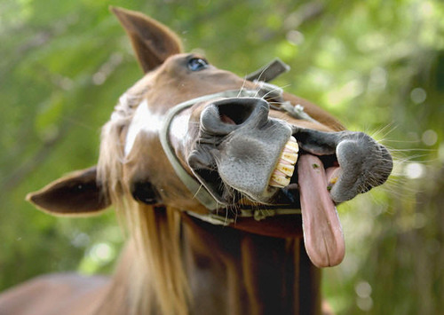
Silly Old Horses Can’t Always Hear The Other Animals
SOHCAHTOA
WHAT?

Slide 25
Practise
Use Tangent to find the missing lengths on these triangles:
Opposite
Adjacent
O
60˚
Tanϴ=
A
42˚
15cm
11cm

